Slide 1
Data, Environment and Society Lecture 4: More pandas
September 10, 2018
Instructor: Duncan Calllaway
GSI: Salma Elmallah

Slide 2
Announcements
Lab 2 due next Monday
HW1 due Thursday

Slide 3
Today…
Reading discussion – Kleinberg et al, Athey.
We’ll keep working with pandas. Key ideas
Merging data frames
Logical indexing
‘groupby’
See ipynb files in github repo
We’ll just talk a little about the data sets in HW2
Air quality data
I’ll use this ppt for that discussion.

Slide 4
Reading discussion (Kleinberg et al, Athey)
What is the principle thesis of Kleinberg et al and the role of prediction versus inference?
What are the strongest elements of their reasoning? What elements are weakest?
What is Athey’s principle thesis related to the the role of prediction versus inference?
What are the strongest elements of her reasoning? What elements are weakest?
Come to class with ideas for two umbrella policies and two rain dance policies, and two the span between. Have them relate to the course topic -- energy, ej, access.

Slide 5
Kleinberg et al
Umbrella problems are those for which you can directly impact social (or environmental) good
social (or environmental) good a.k.a. the “payoff”
Rain dance problems are those in which you can impact a process that indirectly impacts social or environmental goods
If your actions directly impact your payoff and not the underlying process, then we only need
to predict the process and
a model of how your actions generate a payoff

Slide 6
Kleinberg key point
Prediction problems are common, well-solved with ML approaches, and important

Slide 7
Kleinberg examples
Candidates for surgery: who will fare well afterwards? Let’s focus on them
predicting which teacher will have the greatest value added
predicting unemployment spell length to help workers decide on savings rates and job search strategies
targeting health inspections
predicting highest risk youth for targeting interventions
lenders identifying the underlying creditworthiness of potential borrowers.

Slide 8
Athey
Key point: We’re not paying enough attention to the limitations of prediction problems
If prediction models don’t factor in the impact of our actions, we may make the wrong decision
Example: In the case of Kleinberg’s surgery, the surgery itself can impact a patient’s long term prognosis.
Building inspections:
High risk does not equate to “easy to fix”
Responsiveness: some firms may be more sensitive to fines than others

Slide 9
Strengths and weaknesses

Slide 10
Class examples
If there will be an increase in respiratory disease due to pollution, then allocate more resources there.
Predict impact of large fires due to heavy fuel loads → guide where to allocate fuel load reduction.
If you subsidize solar, will people install solar roofs?
Based on demographics of a community, will education be effective for increasing solar adoption?
Where will ppl have Evs → build more infrastructure there.
Notes:
Where will fires happen? -- Actions impact prediction because ppl may respond differently
What will be the impact of reducing natural gas burning? Pure prediction? Perhaps not. Maybe other sources will pop up if you reduce natural gas.
Who has electric heating? How will a new policy impact bill costs? Could be some endogeneity here?

Slide 11
EPA air quality data
Here is a link to the source page.
Sources of PM
Many sizes and shapes and can be made up of hundreds of different chemicals.
Some directly from a source: construction sites, unpaved roads, fields, smokestacks or fires.
Most form in the atmosphere by complex reactions of chemicals such as sulfur dioxide and nitrogen oxides

Slide 12
More on PM2.5…
(text adapted from epa.gov) Health effects:
premature death in people with heart or lung disease
nonfatal heart attacks
irregular heartbeat
aggravated asthma
decreased lung function
increased respiratory symptoms, such as irritation of the airways
Environmental effects
makes lakes and streams acidic
changes the nutrient balance in coastal waters and large river basins
depletes soil nutrients
damages sensitive forests and farm crops
affects the diversity of ecosystems
contributes to acid rain

Slide 13
PM2.5 monitoring
Go here to see cool maps
And go here to see a list of locations
But, how many sensors?
Oakland has three
Berkeley has one, near the Marina
However as you may imagine, pollution is much more heterogeneous…

Slide 14
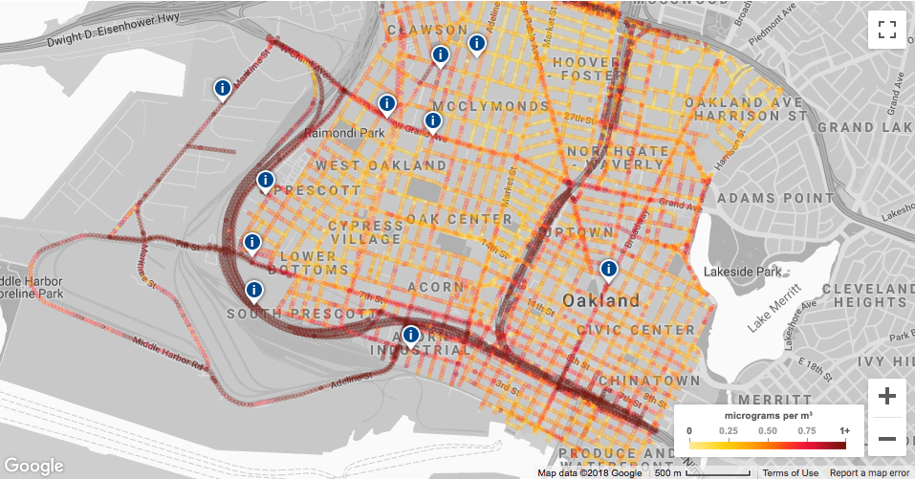
Example: Improving air quality assessments
Josh Apte (ERG PhD alum) partnered with Google, Environmental Defense and West Oakland Environmental Indicators Project to generate air quality data of unprecedented resolution

Slide 15
PurpleAir…
…sells internet-connected air quality sensors
Here is a map of where we live

